Slide 1
微机原理与接口技术
Theory and Interface Technology of Microcomputer
北京化工大学
信息科学与技术学院
主讲教师： 郭青
guoqing@mail.buct.edu.cn

Slide 2
CHAPTER 4 MEMORY

Slide 3
4.1 Introduction
The memory of a computer holds (stores) program instructions (what to do),data (information), operands (affected, manipulated, or operated upon data), and calculations (ALU results).
The CPU controls the information stored in memory.
Information is fetched, manipulated (under program control) and/or written (or written back) into memory for immediate or later use.
存储器是计算机系统中的记忆设备，用来存储程序和数据

Slide 4
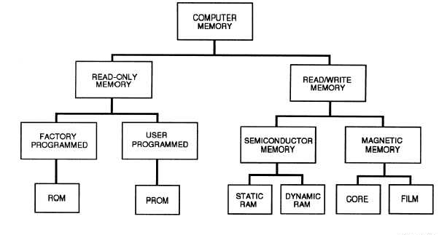
4.1 Introduction
Fig. 4.1 classification of memory

Slide 5
4.1 Introduction
4.1.1 classification of memory 存储器分类
存储元
一个二进制代码位，是最小的存储单位
存储单元
由若干个存储元组成
存储器
1、按存储介质分类
半导体存储器
semi-conductor memory
magnetic memories
例：磁盘存储器，磁带存储器
磁表面存储器

Slide 6
introduction
2、按存取方式分类
随机存储器
半导体存储器，磁芯存储器
顺序存储器
磁带存储器
即：直接存取存储器（DAM）访问时读/写部件先
直接指向一个小区域，再在该区域内顺序查找。
访问时间与数据位置有关。磁盘存储器
半顺序存储器
3、按存储器的读写功能分类
只读存储器（ROM）
随机存储器（RAM）
4、按信息的可保存性分类
永久性存储器
磁盘存储器，ROM
非永久性存储器
RAM

Slide 7
Introduction
5、按串、并行存取方式分类
并行存储器
串行存储器
6、按在计算机系统中的作用分类
主存储器
辅助存储器
缓冲存储器
控制存储器

Slide 8
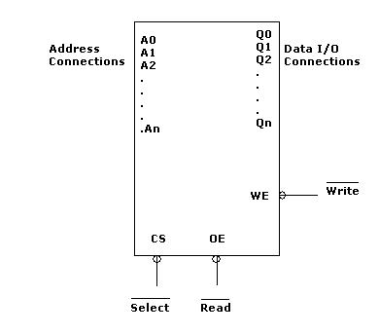
4.1.2 Memory Pin Connections
Fig 4.2 Basic memory component connections

Slide 9
4.1.2 Memory Pin Connections
Address Connections 地址输入端
Select a memory location within the memory device.
Labeled from A₀ (the least-significant address input)
to A_{n} (the most-significant address input)
subscript n: one less than the total number of address pin
Number of address pin is determined by the number of memory location within it
EX: 1K memory → 10 address pin A0 ~ A9
11 address pin → 2K memory A0 ~ A10

Slide 10
4.1.2 Memory Pin Connections
Data Connections 数据端
Data output or input/output (I/O)
At which data are entered for storage or extracted for reading.
Labeled D0 ~ D7 for an eight-bit-wide memory.
Labeled IO0~IO7 for bidirectional data connections.
Catalog listings of memory devices often refer to memory locations times bits per location.
EX: 1K×8 1K memory and 8 bits in each location
16K×1 contains 16K one-bit memory location

Slide 11
4.1.2 Memory Pin Connections
Selection Connections 芯片选择端
Each memory device has an input — sometimes more than one — that selects or enables the memory device.
Chip select (CS) 芯片选择端
Chip enable (CE) 芯片允许端
Select (S) 选择端
If the selection input is active (logic 0, if with overbar), the memory device performs a read or write operation;
If it is inactive ( a logic 1, in this case), the memory is turned off or disables, and cannot do a read or a write.
If more than on CS is present, all must be activated to read or write data

Slide 12
4.1.2 Memory Pin Connections
Control Connections 控制端
All memory devices have some form of control input or output. A ROM usually has only one control input, while a RAM often has one or two control inputs.
For ROM: output enable — OE or gate G 输出允许
if OE and CE are both active, the output is unable
For RAM: one or two control inputs
If only one, it is often called R/W. 读/写控制
If two, usually labeled WE (write enable) and OE
WE must be active to perform a memory write
OE must be active to perform a memory read.
The two controls must never both be active at the same time

Slide 13
4.1.3 Memory Hierarchy
存储器分级结构
Memory Hierarchy is to obtain the highest possible access speed while minimizing the total cost of the memory system
Auxiliary memory
Magnetic
tapes
I/O
Main
主存储器
processor
memory
Magnetic
disks
CPU
Cache
高速缓冲存储器
辅助存储器
外存储器
memory
Fig. 4.3 Memory hierarchy

Slide 14
4.1.3 Memory Hierarchy
Several memory levels
Each of which has different purposes;
Be accessed within different time limits.
o The fastest access is for the register set located directly on the CPU， but space available is limited.
o Cache memory keeps frequently used data to which it provides faster access than the main RAM. Cache memory is fast-access SRAM memory, which is more expensive and used in limited amounts.
o The main memory (RAM) is typically slow to access but has a much larger capacity of holding information.
Register
Cache
Main Memory
Magnetic Disk
Magnetic Tape
Fig. 4.4
memory levels

Slide 15
4.1.4 memory performance
1. Capacity (memory size) 存储容量
一个存储器中可以容纳的存储单元总数，称为该存储器的存储容量
The capacity is described using bits(b) or byte (B).
EX: described as containing 65,536 bits, 64Kb;
alternately, it maybe called an “8K by 8”, 8KB memory.
2. Access time (memory speed) — 存取时间
又称存储器访问时间，是指启动一次存储器操作到完成该操作所经历的时间。速度指标
Access time is a measure of the time required to read from or write the data to a particular address in the memory. It is the interval from the instant at which a request for data is initiated until the data is available for use.
It can range from a few nanoseconds (ns) to microseconds (µs).

Slide 16
4.2 Common Memory Device
Main memory
Read-only memory ROM
Flash memory EEPROM
(electrically erasable programmable ROM)
Random access memory RAM
Static random access memory SRAM
Dynamic random access memory DRAM

Slide 17
4.2.1 ROM
ROM — read-only memory
Permanently stores programs and data that are resident to the system and must not change when the power supply is disconnected.
Nonvolatile memory 永久性存储器
— its contents do not change even if power is disconnected.
ROM — programmed at factory and cannot be altered.
EPROM (erasable programmable read-only memory)
— programmed in the field on an EPROM programmer
PROM — programmed in the field, but once it is programmed, it cannot be erased.
Flash memory, EEPROM, EAROM (electrically alterable ROM) — electrically erasable in the system

Slide 18
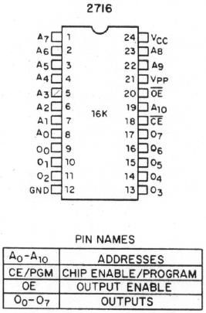
4.2.1 ROM
Typical ROM chip 2716 EPROM
2K×8 EPROM
read-only memory
11 address inputs
8 data outputs
Chip selection input CE
Output enable pin OE

Slide 19
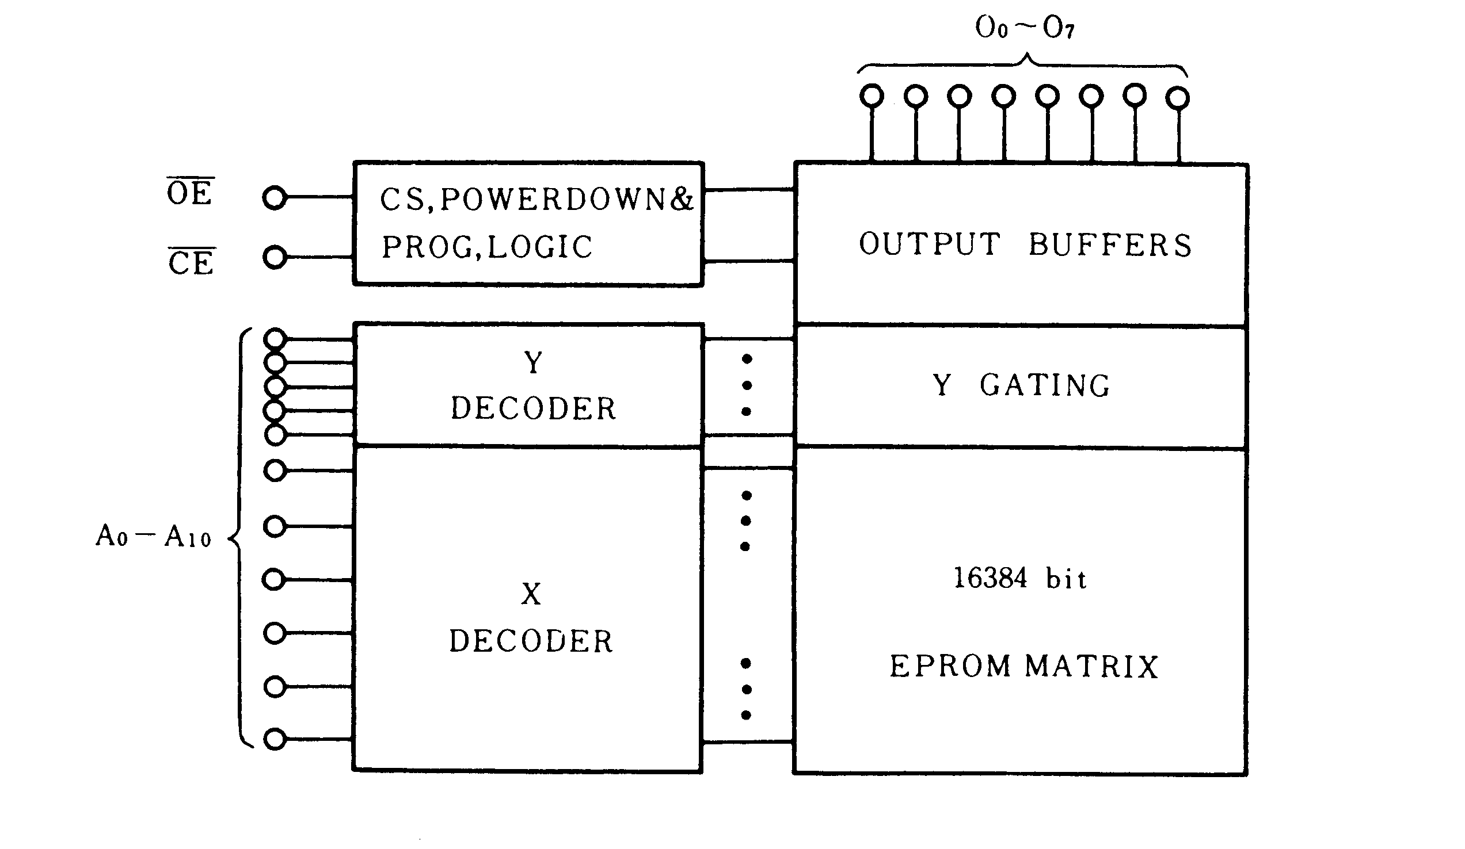
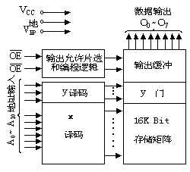
4.2.1 ROM
Typical ROM chip 2716 EPROM
Block diagram

Slide 20
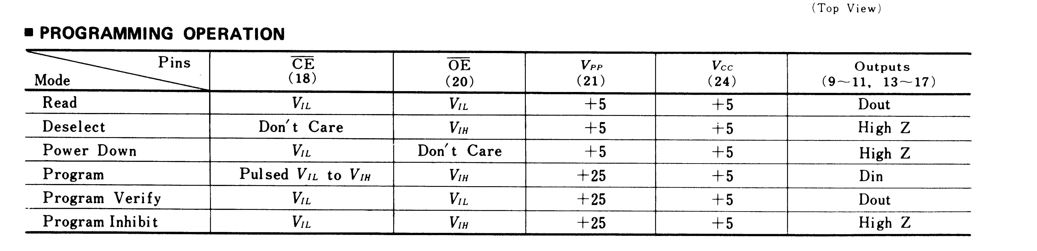
4.2.1 ROM
Typical ROM chip 2716
V_{IH}
2716 Mode Selection
读，输出禁止，低功耗，编程，编程校验，编程禁止

Slide 21
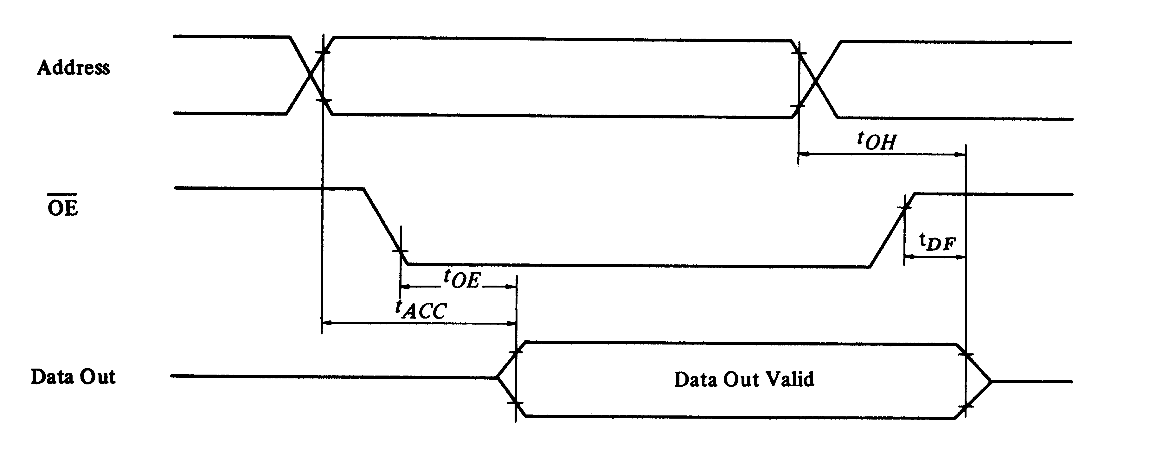
4.2.1 ROM
Typical ROM chip 2716
Read mode CE = V_{IL}
Time diagram of 2716

Slide 22
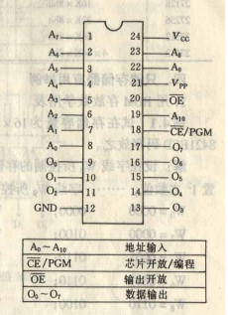
4.2.1 ROM
EEPROM 2816
2816是容量2K×8的电擦除PROM，芯片的引脚排列与2716一致，只是在管脚定义上，数据线管脚对2816来说是双向的。以适应读写工作模式。
突出特点：可以以字节为单位进行擦除和重写。

Slide 23
Intel 2816的工作方式选择
管脚 方式 | CE | OE | Vpp | 数据线功能
读方式 | 低 | 低 | ＋4～＋6 | 输出
备用方式 | 高 | × | ＋4～＋6 | 高阻
字节擦除 | 低 | 高 | ＋21 | 输入为 高电平
字节写 | 低 | 高 | ＋21 | 输入
片擦除 | 低 | ＋9V～＋15V | ＋21 | 输入为 高电平
擦写禁止 | 高 | × | ＋21 | 高阻

Slide 24
4.2.1 ROM
FLASH Memory
1. 闪速存储器是一种高密度、非易失性的读/写半导体存储器，
它突破了传统的存储器体系，改善了现有存储器的特性。
闪速
存储
器的
特点
固有的非易失性
廉价的高密度
可直接执行

Slide 25
4.2.1 ROM
FLASH Memory
2、用于存放BIOS
BIOS是BASIC INPUT/OUTPUT SYSTEM的缩写，即基本输入/输出系统。
实际上，BIOS是一个程序，而且是计算机系统的一个核心程序，控制着计算机部件（包括板卡，外设）的运作,负责在开机时检测，初始化系统设备、装入操作系统并调度OS向硬件发出的指令，是一个系统模块。

Slide 26
4.2.2 RAM
Random Access Memory, or read/write memory
The data can be retrieved from memory, altered, and written back into memory.
Their physical makeup can be magnetic or semiconductor.
Semiconductor memories cost less, are faster in terms of storage and access time, and use nondestructive readout.
Magnetic memories are relatively low in cost, require less power, and are nonvolatile.

Slide 27
4.2.2 RAM
Static RAM (SRAM) semiconductor RAM
Retain data for as long as DC power is applied.
No special action (except power) is required to retain store data. 无需刷新
SRAM devices are also called volatile memory, because they will not retain data without power. 非永久性存储器
Capacity of common SRAM is small, less than 1M byte.
High access speed, used in CACHE memory system
在工作过程中，可以随机的读写

Slide 28
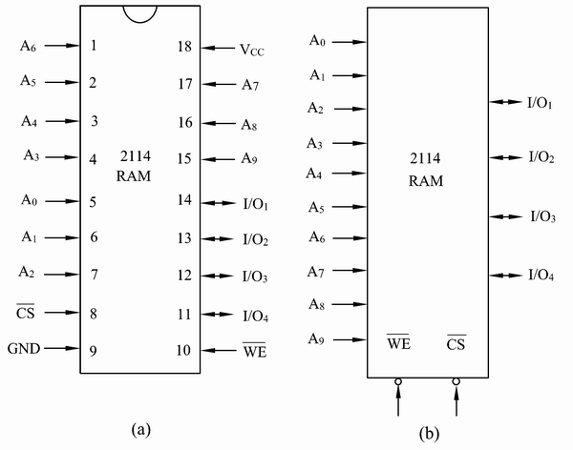
4.2.2 RAM
Intel 2114 1K×4 SRAM NMOS
A0～A9 : Address
I/O1～I/O4:
Data in/Data output
CS: Chip selection
WE: Write enable
WE=0: Write
WE=1: Read

Slide 29
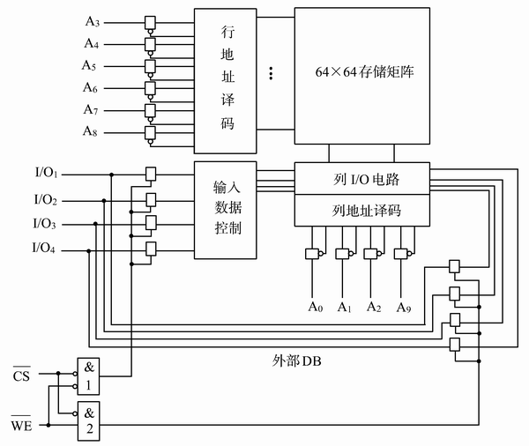
4.2.2 RAM
Intel 2114 1K×4 SRAM NMOS

Slide 30
4.2.2 RAM
Dynamic RAM (DRAM)
Retains data for only 2 or 4ms. After 2 or 4ms, the contents of the DRAM must be completely rewritten (refreshed).
存储时间短，信息易丢失，需每隔一段时间刷新一次。
much larger size: up to 512M×1.

Slide 31
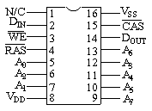
4.2.2 RAM
Intel 2164A 64K×1
A0~A7 | 地址输入
CAS | 列地址选通
D_{IN} | 数据输入
D_{OUT} | 数据输出
WE | 写开放
RAS | 行地址选通
V_{DD} | +5V
V_{SS} | 地

Slide 32
4.2.2 RAM
高集成度DRAM
存储芯片容量变大。1M×1、1M×4、4M×1、16M×1等。
片内集成刷新电路。
Memory Module 内存条
SIMM (single In-line Memory Module) 单列直插式
30-pins 8-bits-wide
72-pins 32 or 36-bits-wide
DIMM (dual In-line Memory Module) 双列直插式
168-pins 64-bits-wide data bus

Slide 33
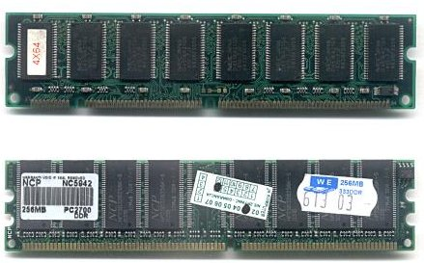

Memory Module
Two types of DIMMs (Dual Inline Memory Modules):
a 168-pin SDRAM module (top) and a 184-pin DDR SDRAM module (bottom)
DDR: Double Data Rate
3 SDRAM DIMM slots

